Slide 1
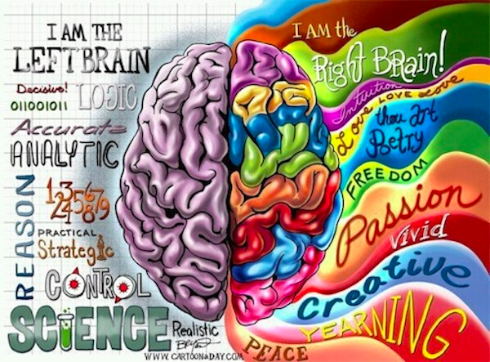

Slide 2
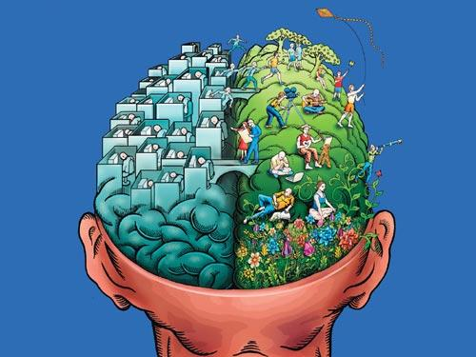
Logic
Language
Sequencing
Emotions
Experiential
Creativity
Notes:
We want to build t bridges between the two hemispheres….emotional dessert/emotional flood

Slide 3
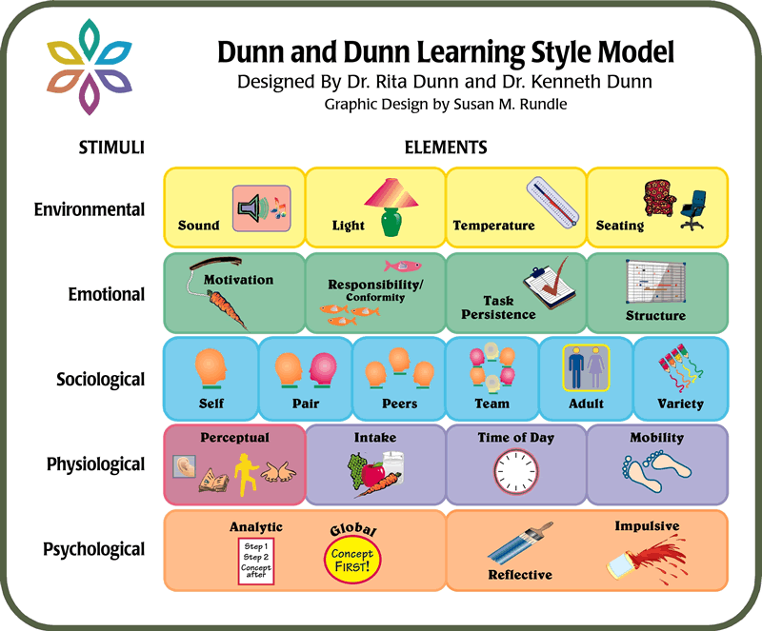
Notes:
Environment
Emotional - What motivates - Do clients need a lot of emotional support – Are the self-directed/Will they stay on task – Do they need structure
Sociological – Do clients learn best alone or working with someone/How much guidance do clients need or want
Physiological – Auditory, Visual, Tactual or Kinesthetic
Psychological – Does the client jump into problems or pause to reflect – external vs internal processors

Slide 4
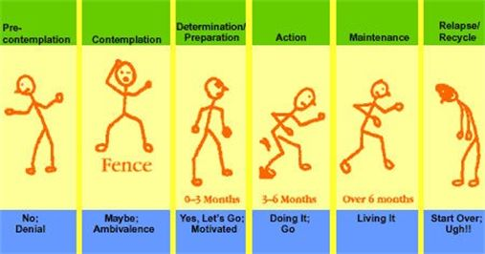
Stages of Change

Slide 5


Slide 6
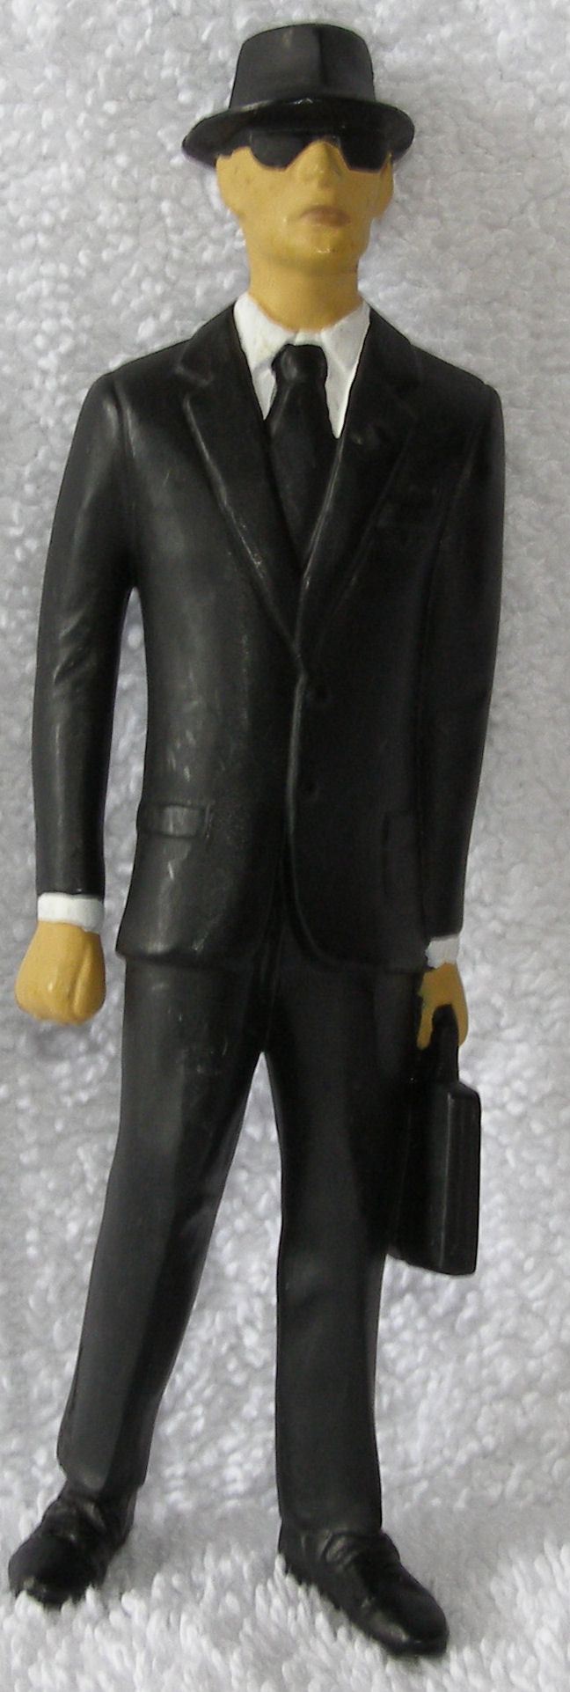

Slide 7
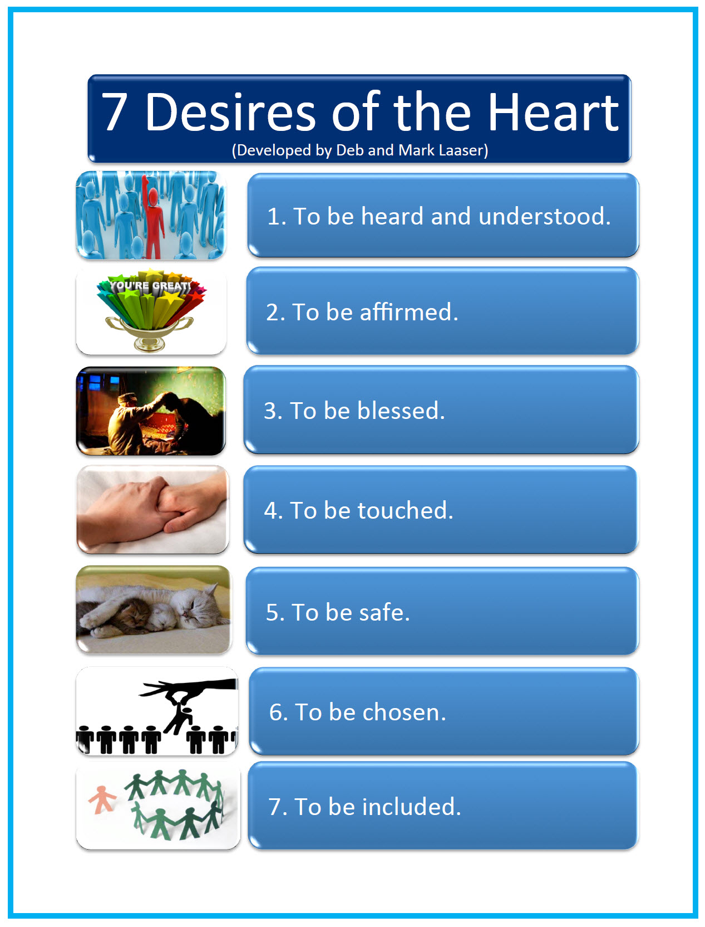

Slide 8
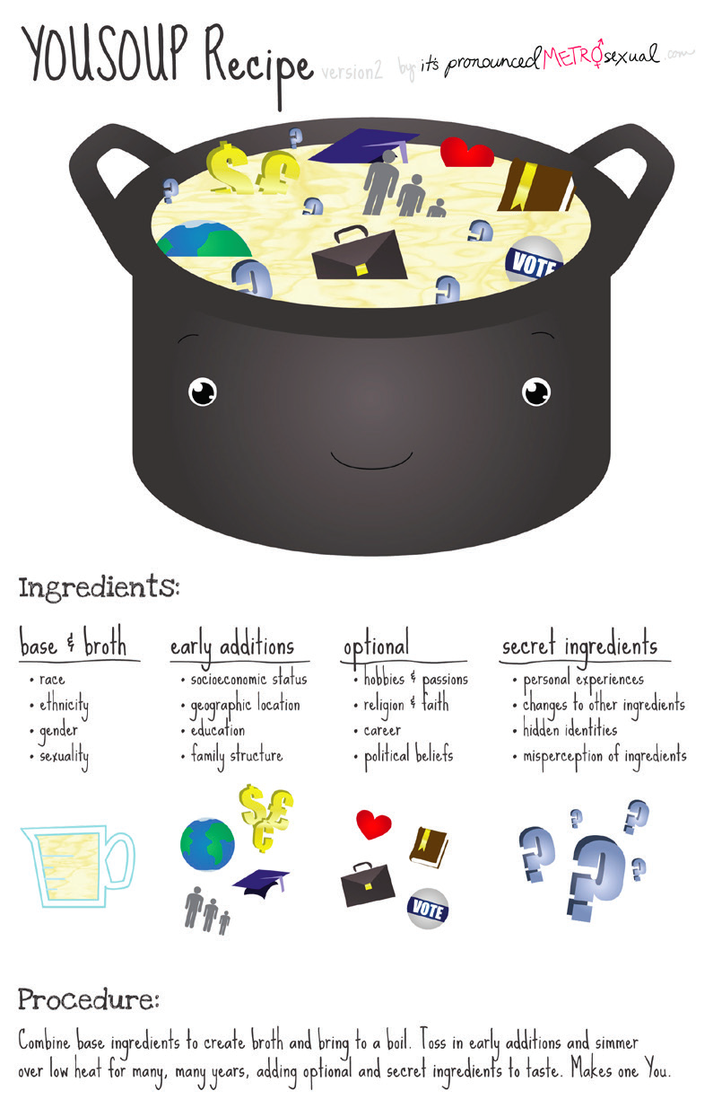

Slide 9
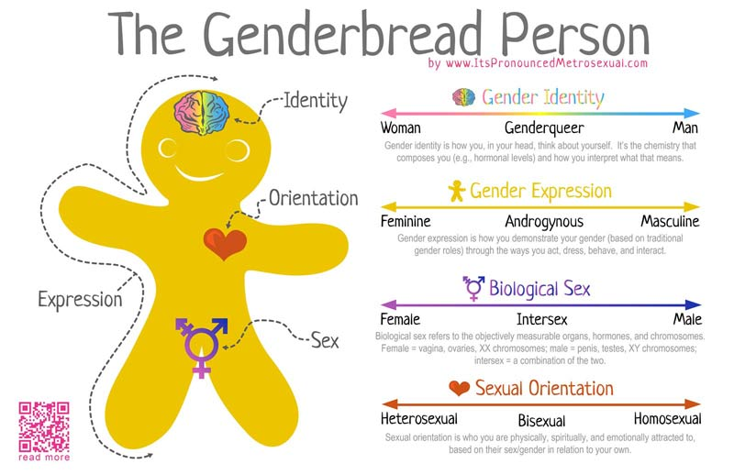

Slide 10
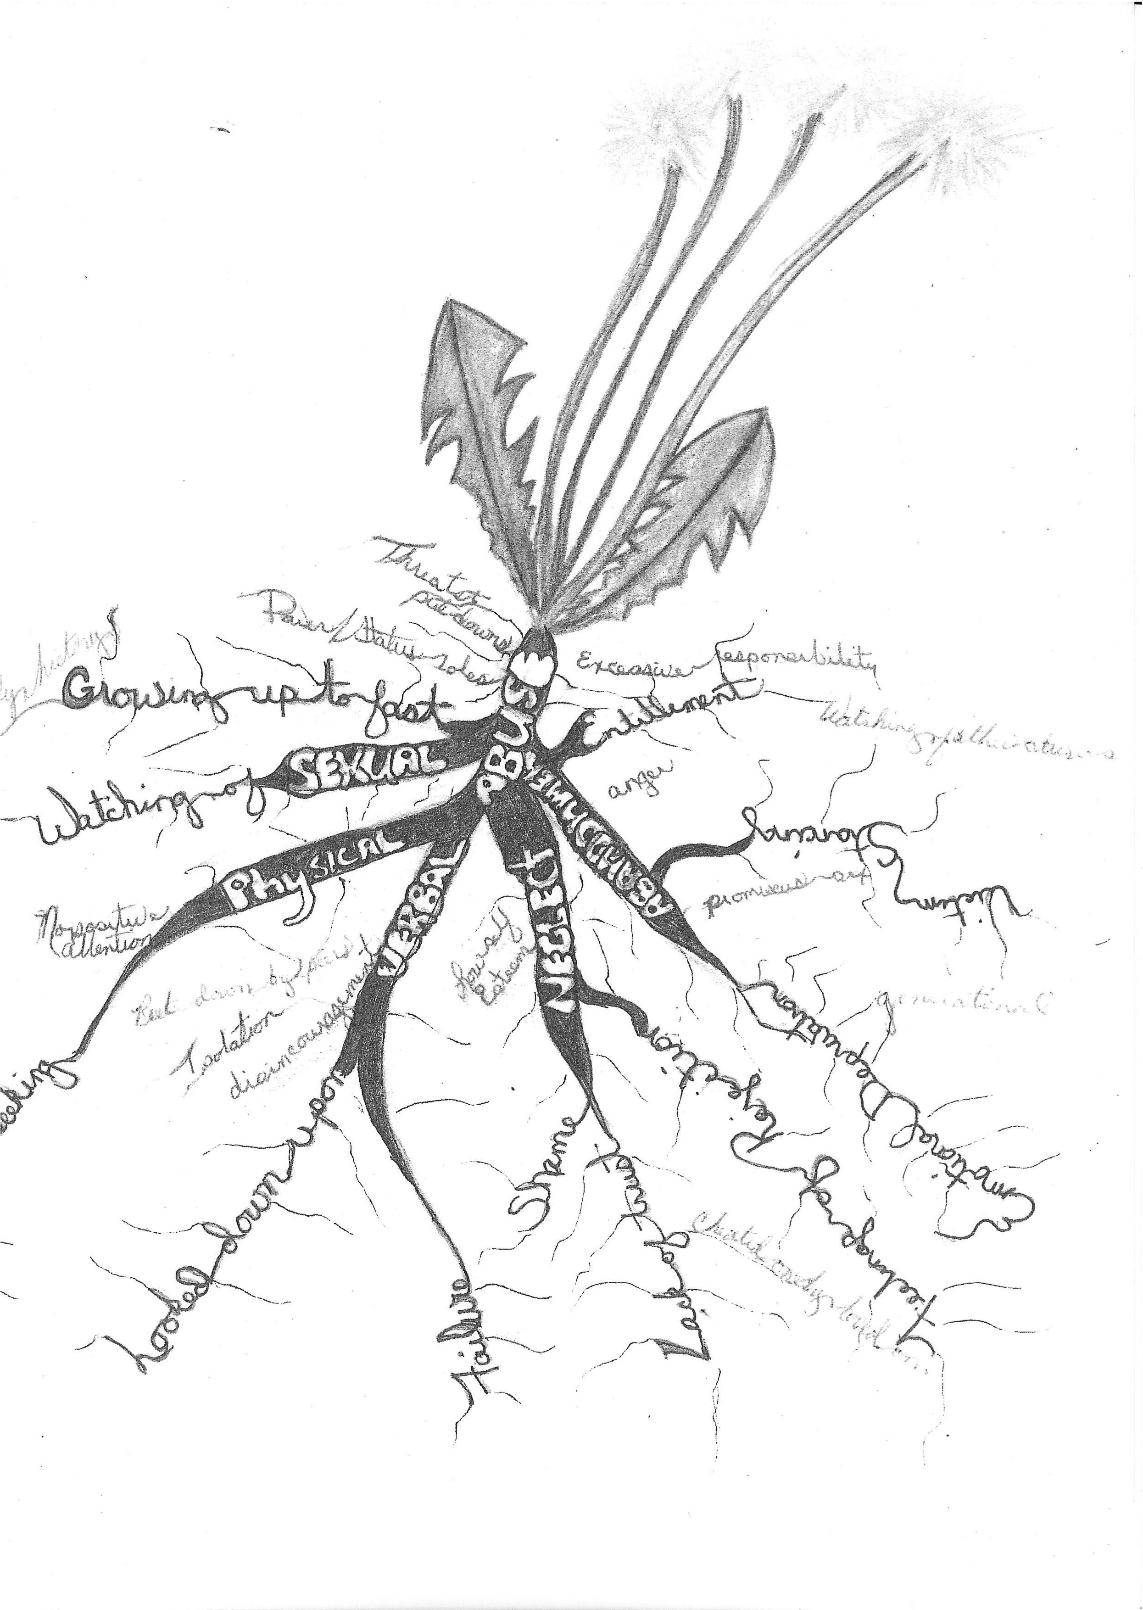

Slide 11


Slide 13


Slide 14


